Slide 1
The Music Board
Glenn Norris Jr
Digital Design Lab (CMPE 3432)
Dr. Lei
Dec 5 2016

Slide 2
Overview
Motivation
Components
Process
Simulation
Improvements
Conclusion

Slide 3
Motivation
Motivation behind this project was to generate music tones using the FPGA Board
Map Two Octaves of Music Notes to computer keyboard
Utilize the information gained from the course(DDL) to accomplish this

Slide 4
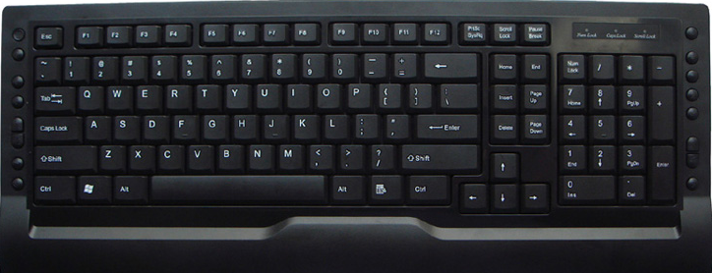
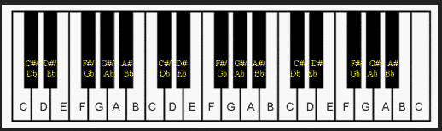
Map Keys to correspond to piano keys

Slide 5
Components
FPGA Board
Bread Board
Connector Wires
Keyboard
ISE Interface
Logic 1.2.3
Speakers

Slide 6
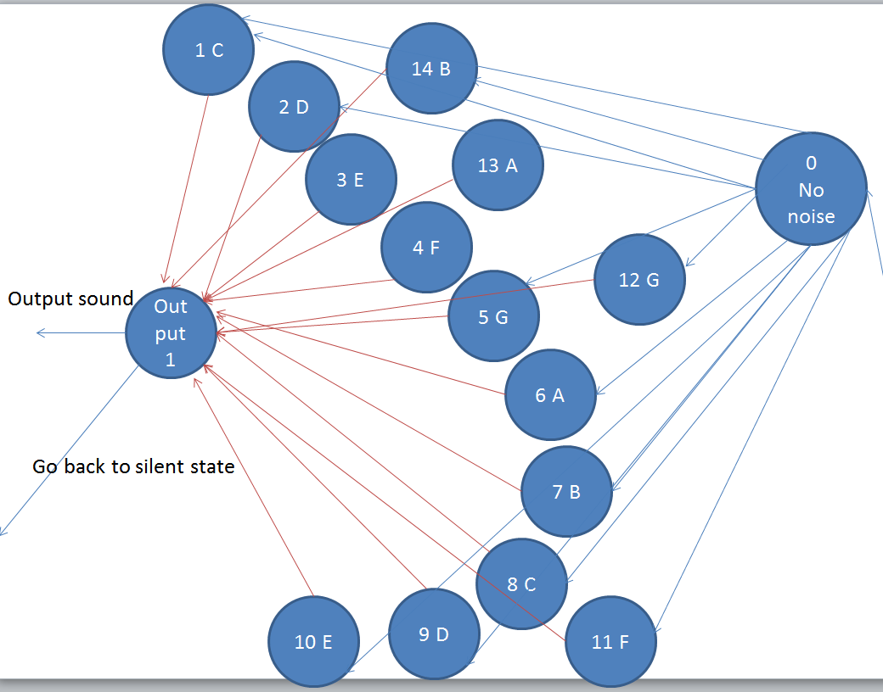
Process
Develop State Diagram
  Initial State Diagram
Cons : real hard to follow
  Hard to debug

Slide 7
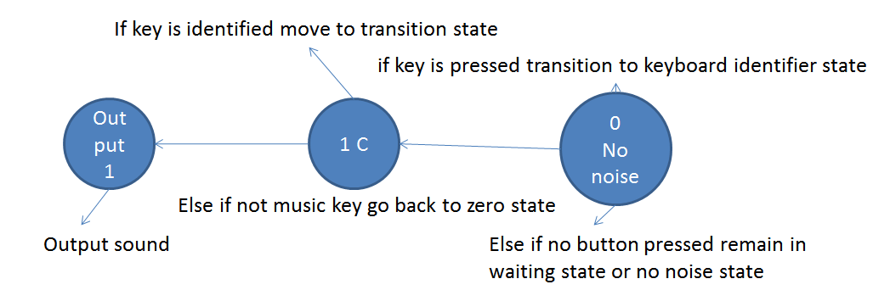
Final State Diagram
Pros : Easier to debug and follow the output
  Much simpler than other diagram
  Easier to debug

Slide 8
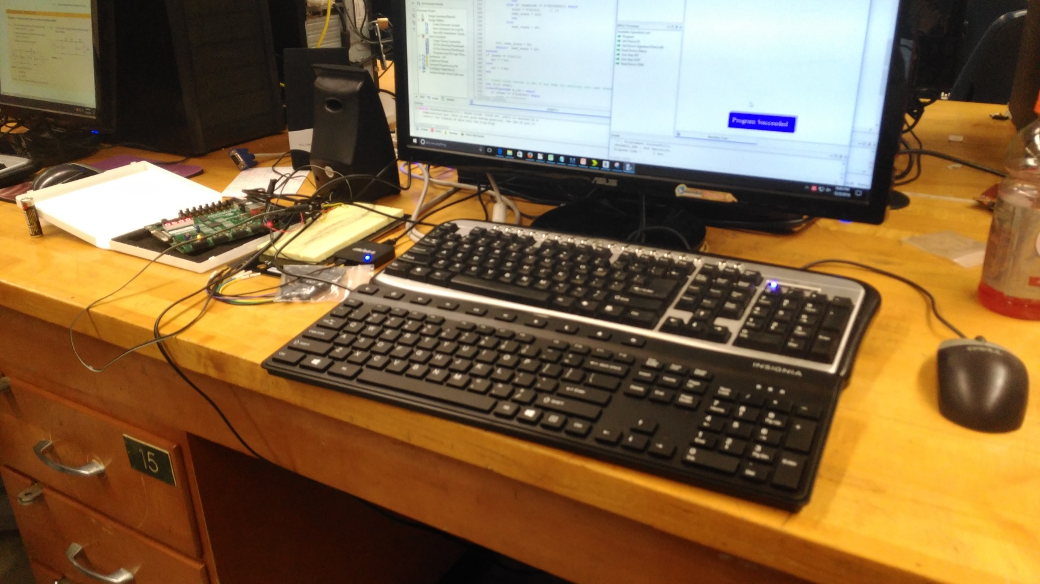
Set Up
Speaker, Circuit, FPGA, Keyboard

Slide 9

Generate Wave Form to Represent Tone
Using Mathcad, given fpga clock frequency & note frequency find the number of clock tics to create a counter which will generate step wave for sound

Slide 10
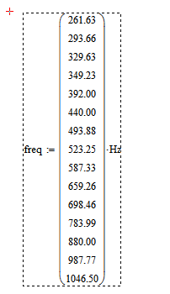
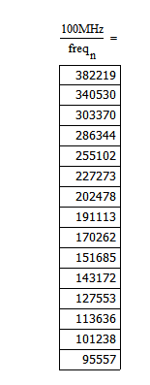
Able to calculate counter values
Given key frequencies around middle A

Slide 11

Able to produce Wave Forms such as
A
C

Slide 12
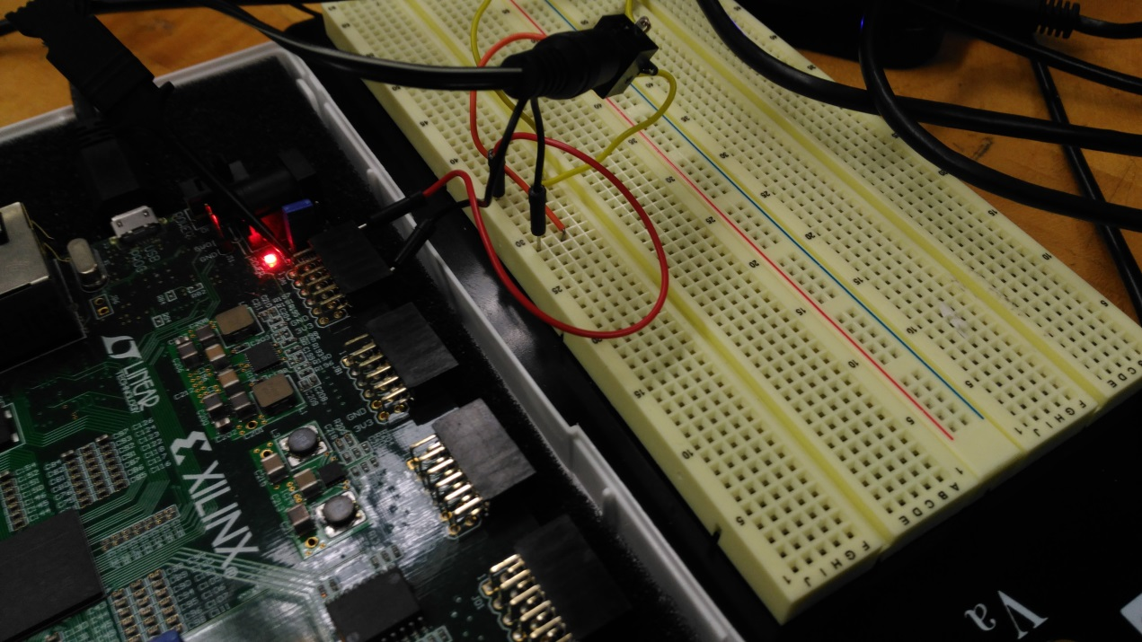
Outputting to Speaker
Using Pmod, Wire Connectors, Speaker

Slide 13
Simulation
I will now demonstrate the keyboard live

Slide 14
Improvements
Transition from Key Note to Key Note more smooth and quicker
Use more of sinusoidal wave instead of a step wave
When key is pressed tone should generate until it is released

Slide 15
Conclusion
Use FPGA Board to generate music notes
Applied knowledge acquired from course to achieve this
Using keyboard output the sounds generated from FPGA Board
Special Thanks to Professor Lei
  Also Classmates

